Slide 1
如有奇怪的言論，不代表本人立場，
一定是暫時被附身，請勿當真
(雖然有些人可能錄影存證，但我不會承認)
(請大家自動消音，那絕對不是我的聲音)

Slide 2
End-to-End Testing: Cypress
CPSD
Tissue

Slide 3






Cypress Training
Testing Concept
Cypress Introduction
Basic Testing Script
Front end testing basic concept: TDD, BDD
Testing pyramid
What is Cypress?
The feature of Cypress
Use exercise to be familiar with Cypress testing script (test case, query element, assertion)
Plugin
Testing report
Mock Test
Use TypeScript as test language
Use Cucumber as Test script
Other tips…
How to get test result report and visual difference report. Make E2E can merge into CI flow
Test double to make testing without data limitation

Slide 4
Agenda
04
Network request
05
Testing Result
06
Plugin
Request
Stub response

Slide 5
Network Request
可以選擇要實際打server，或是要使用stub

Slide 6
Network Traffic Control
Cypress幫助APP測試Ajax/XHR lifecycle，常見的測試方式有:
Asserting on a request’s body
Asserting on a request’s url
Asserting on a request’s headers
Stubbing a response’s body
Stubbing a response’s headers
Stubbing a response’s status code
Delaying a response
Waiting for a response to happen

Slide 7
Network Traffic Control
Asserting
常用的assertion of request:

Slide 8
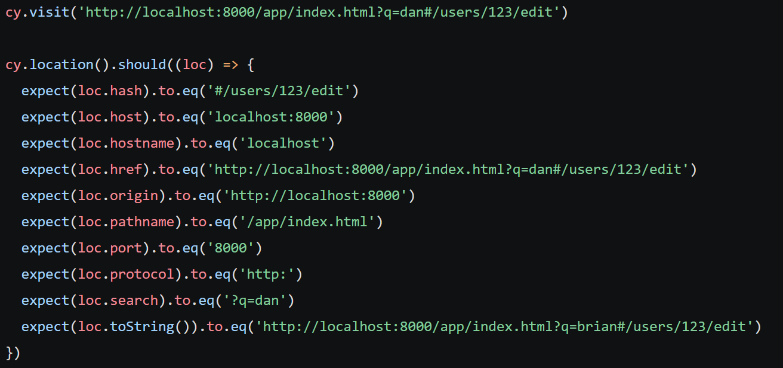
Network Traffic Control
Asserting
location(): Get global window.location object of the page that is currently active.
url(): Get the current URL of the page that is currently active. (= cy.location('href'))
hash(): Get the current URL hash of the page that is currently active. (= cy.location('hash’))

Slide 9
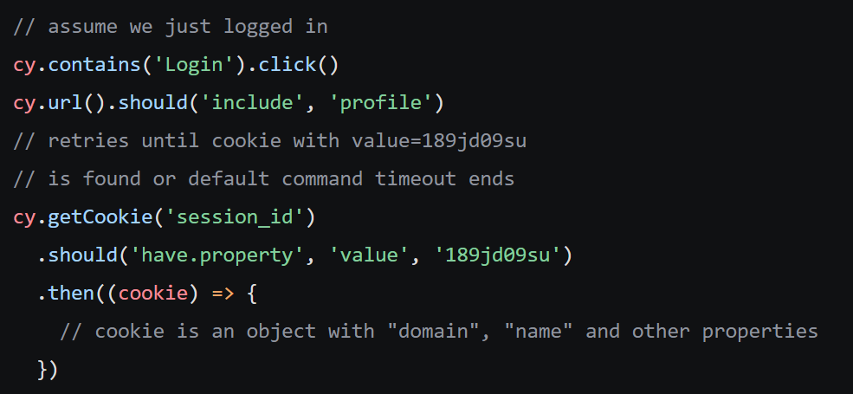
Network Traffic Control
Asserting
cookies()
cy.getCookie(name), cy.getCookies(): get browser cookies.
clearCookie(name), cy.clearCookies(): clear cookie

Slide 10
Request and assertion 小練習

Slide 11
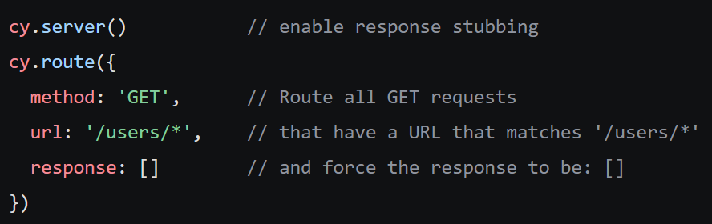
Network Traffic Control
Server & route
為了要stub response，有兩件事情要做:
Start a cy.server()
Provide a cy.route()

Slide 12


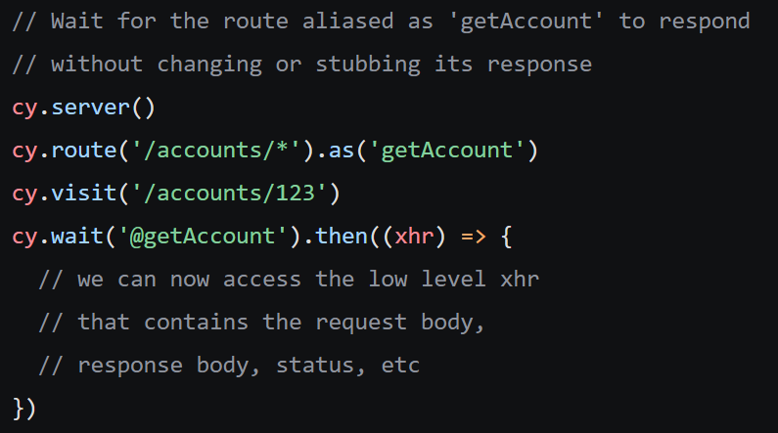
Network Traffic Control
Waiting
Waiting for a response to happen: cy.wait()
等待的時間:
等到特定的request有response

Slide 13
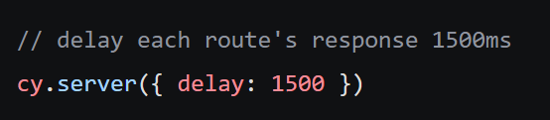
Network Traffic Control
Delay
Change the default delay for all routes - cy.server({ delay: 1500 })
如果stub response速度非常的快(< ms)，可以透過delay時間的方式去模擬實際網路延遲

Slide 14
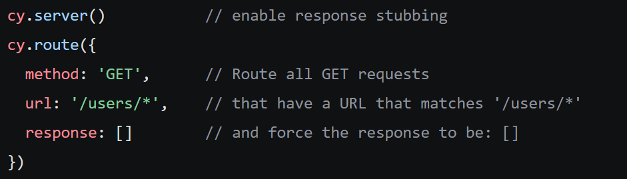
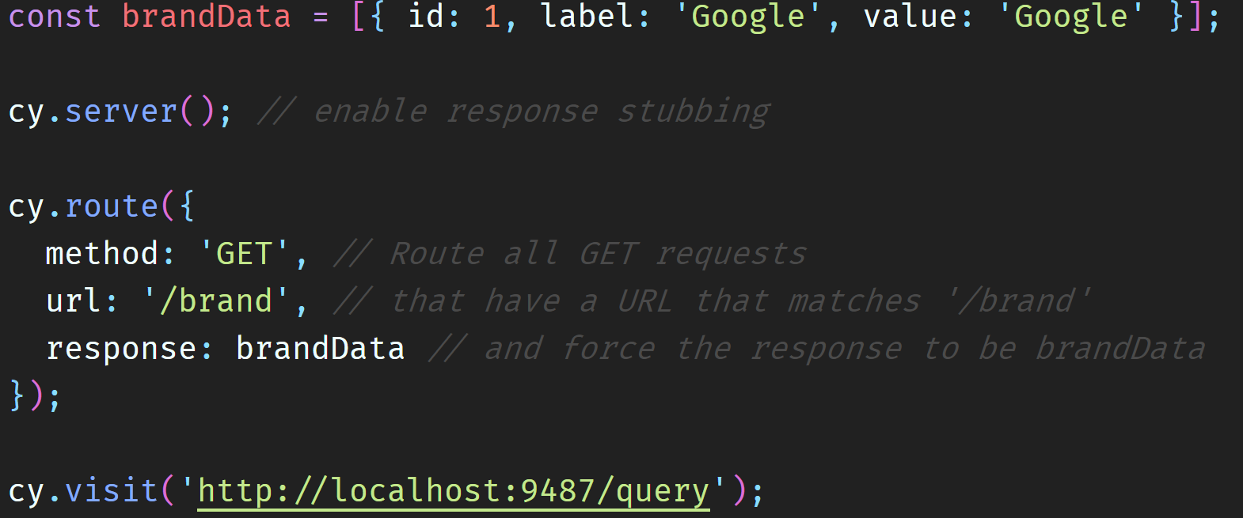
Network Traffic Control
Server & route
Stub response: cy.server(), cy.route()
讓測試的script不受後端回傳的資料 or Db資料的改變，導致測試失敗

Slide 15
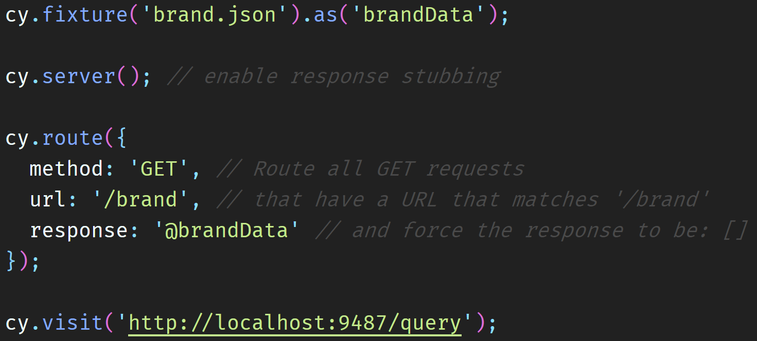
Network Traffic Control
Server & route
Stub response: cy.server(), cy.route() with static resource
將static mock data放在搭配 fixture folder中，搭配cy.fixture().as()，來使用更簡潔
也可以在route()裡直接利用Using fixture or fx shortcuts
1
2

Slide 16
Stub response 小練習

Slide 17
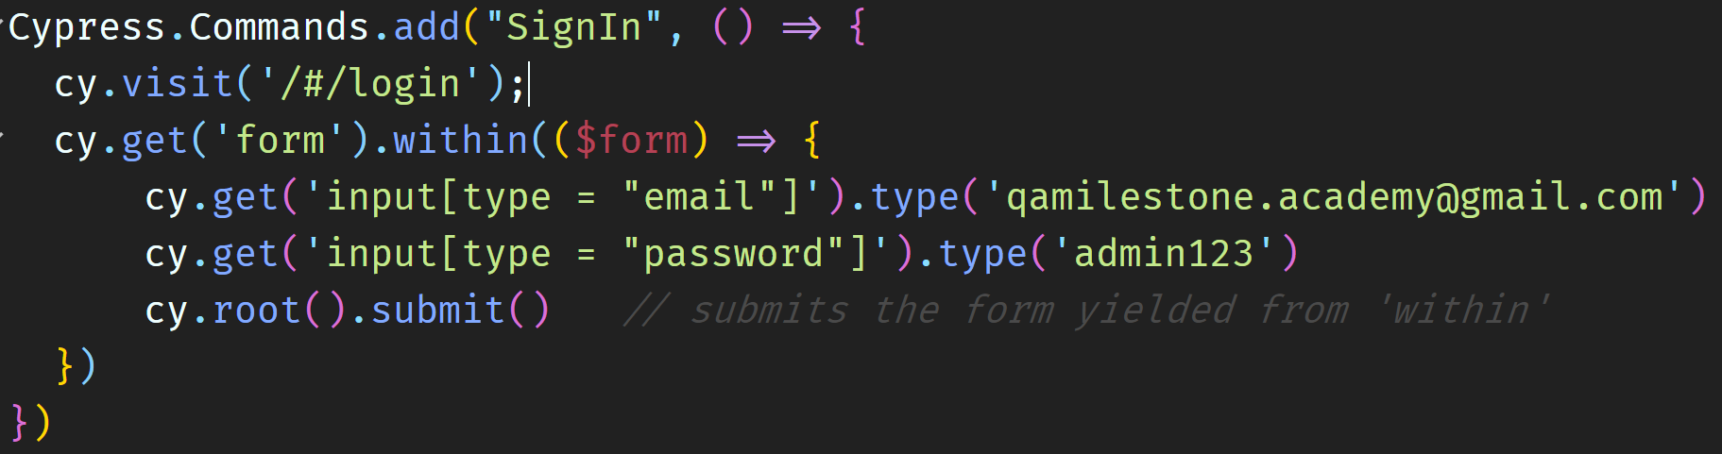
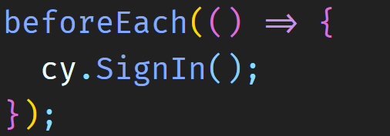
Duplicate URL and function
Duplicate URL prefix
還記得可以設定在哪個json file裡嗎?
Duplicate common function
還記得可以怎麼寫嗎?
Common command放在 support folder – commands.js file
cypress.json 加上baseHref: ‘$urlPrefix’

Slide 18
Common command小練習

Slide 19
Agenda
04
Network request
05
Testing Result
06
Plugin
Run E2E with headless
Testing report
Visual testing diff report

Slide 20
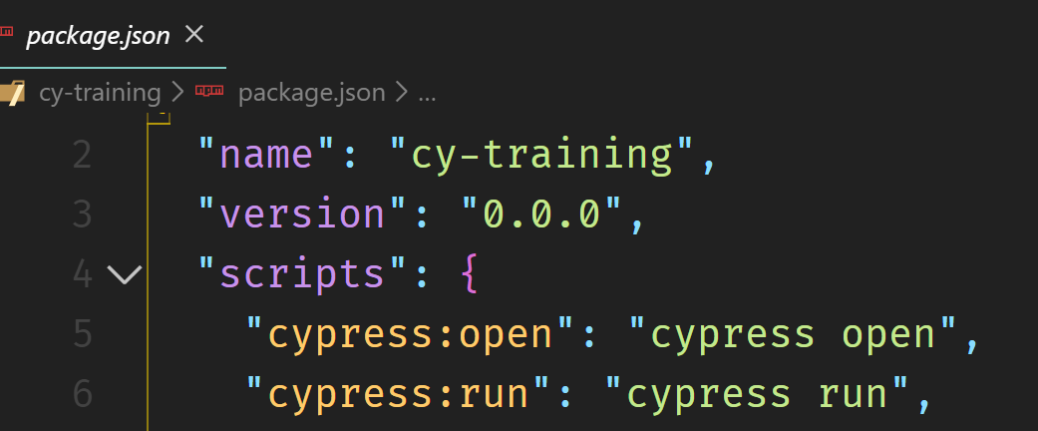
Run Test with headless
跑整個project spec file
npx cypress run
npm run cypress:run (*在package.json裡面有設定)
跑特定資料夾的spec file
npx cypress run --spec “cypress/integration/examples/**/*”
跑某個spec file
npx cypress run --spec “cypress/integration/examples/actions.spec.js”

Slide 21
Run Test with headless
Test Result

Slide 22
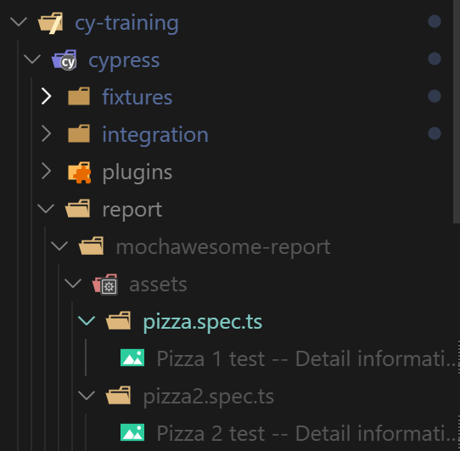
Cypress Screenshot and Video
當測試失敗的時候會截圖，讓你看到當下fail的原因
用cy.screenshot() 也可以手動trigger 截圖
預設節圖會在screenshots資料夾
但提供的template裡因為adopt visual testing script，所以截圖位置在
cypress\report\mochawesome-report\assets\testcase-spec folder裡
測試的過程會自動錄影，在video資料夾裡

Slide 23
Mochawesome Report
Test Result

Slide 24



Visual Testing
執行node cypress_runner
第一次執行時，建立base line image in snapshots folder
有base line image後，執行test script，都會比較current web page and base line
當發現不一致的時候，test case fail並且append diff comparison image在report裡

Slide 25
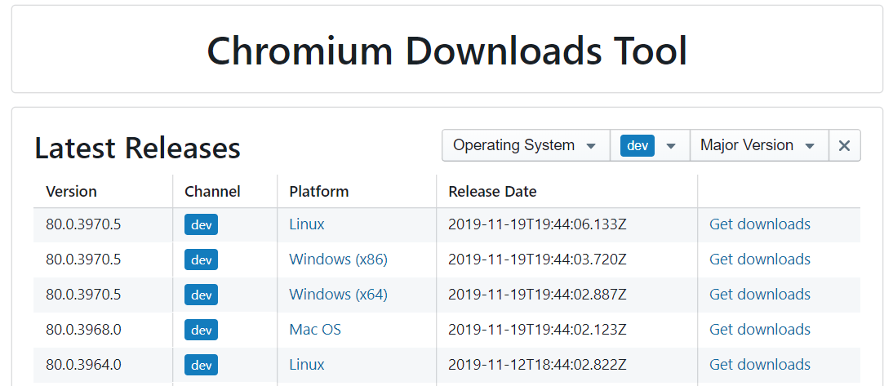
Chrome Testing
Chrome version
On Windows, Cypress scans the following locations to try to find each browser:
Download specific Chrome version - https://chromium.cypress.io/
Browser Name | Expected Path
chrome | C:/Program Files (x86)/Google/Chrome/Application/chrome.exe
chromium | C:/Program Files (x86)/Google/chrome-win32/chrome.exe
canary | %APPDATA%/../Local/Google/Chrome SxS/Application/chrome.exe

Slide 26
Agenda
04
Network request
05
Testing Result
06
Plugin
TypeScript
Cucumber
Other plugin settings

Slide 27




Cypress Training Summary
CONTENTS
CONTENTS
CONTENTS
CONTENTS
Concept
Script
Network
Report
測試金字塔，最重要flow有哪些
官方教學資源非常豐富，
可以搭配服用學習
Stub Response
就不用擔心需要一直改script
精美的測試結果
搭配visual different report
更容易知道錯誤在哪裡

Slide 28
Thank
U

